Slide 1




Department of Water Supply, County of Hawai’i
Lalamilo Wind Farm
“Mixing Wind with Water”

Slide 2
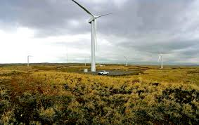
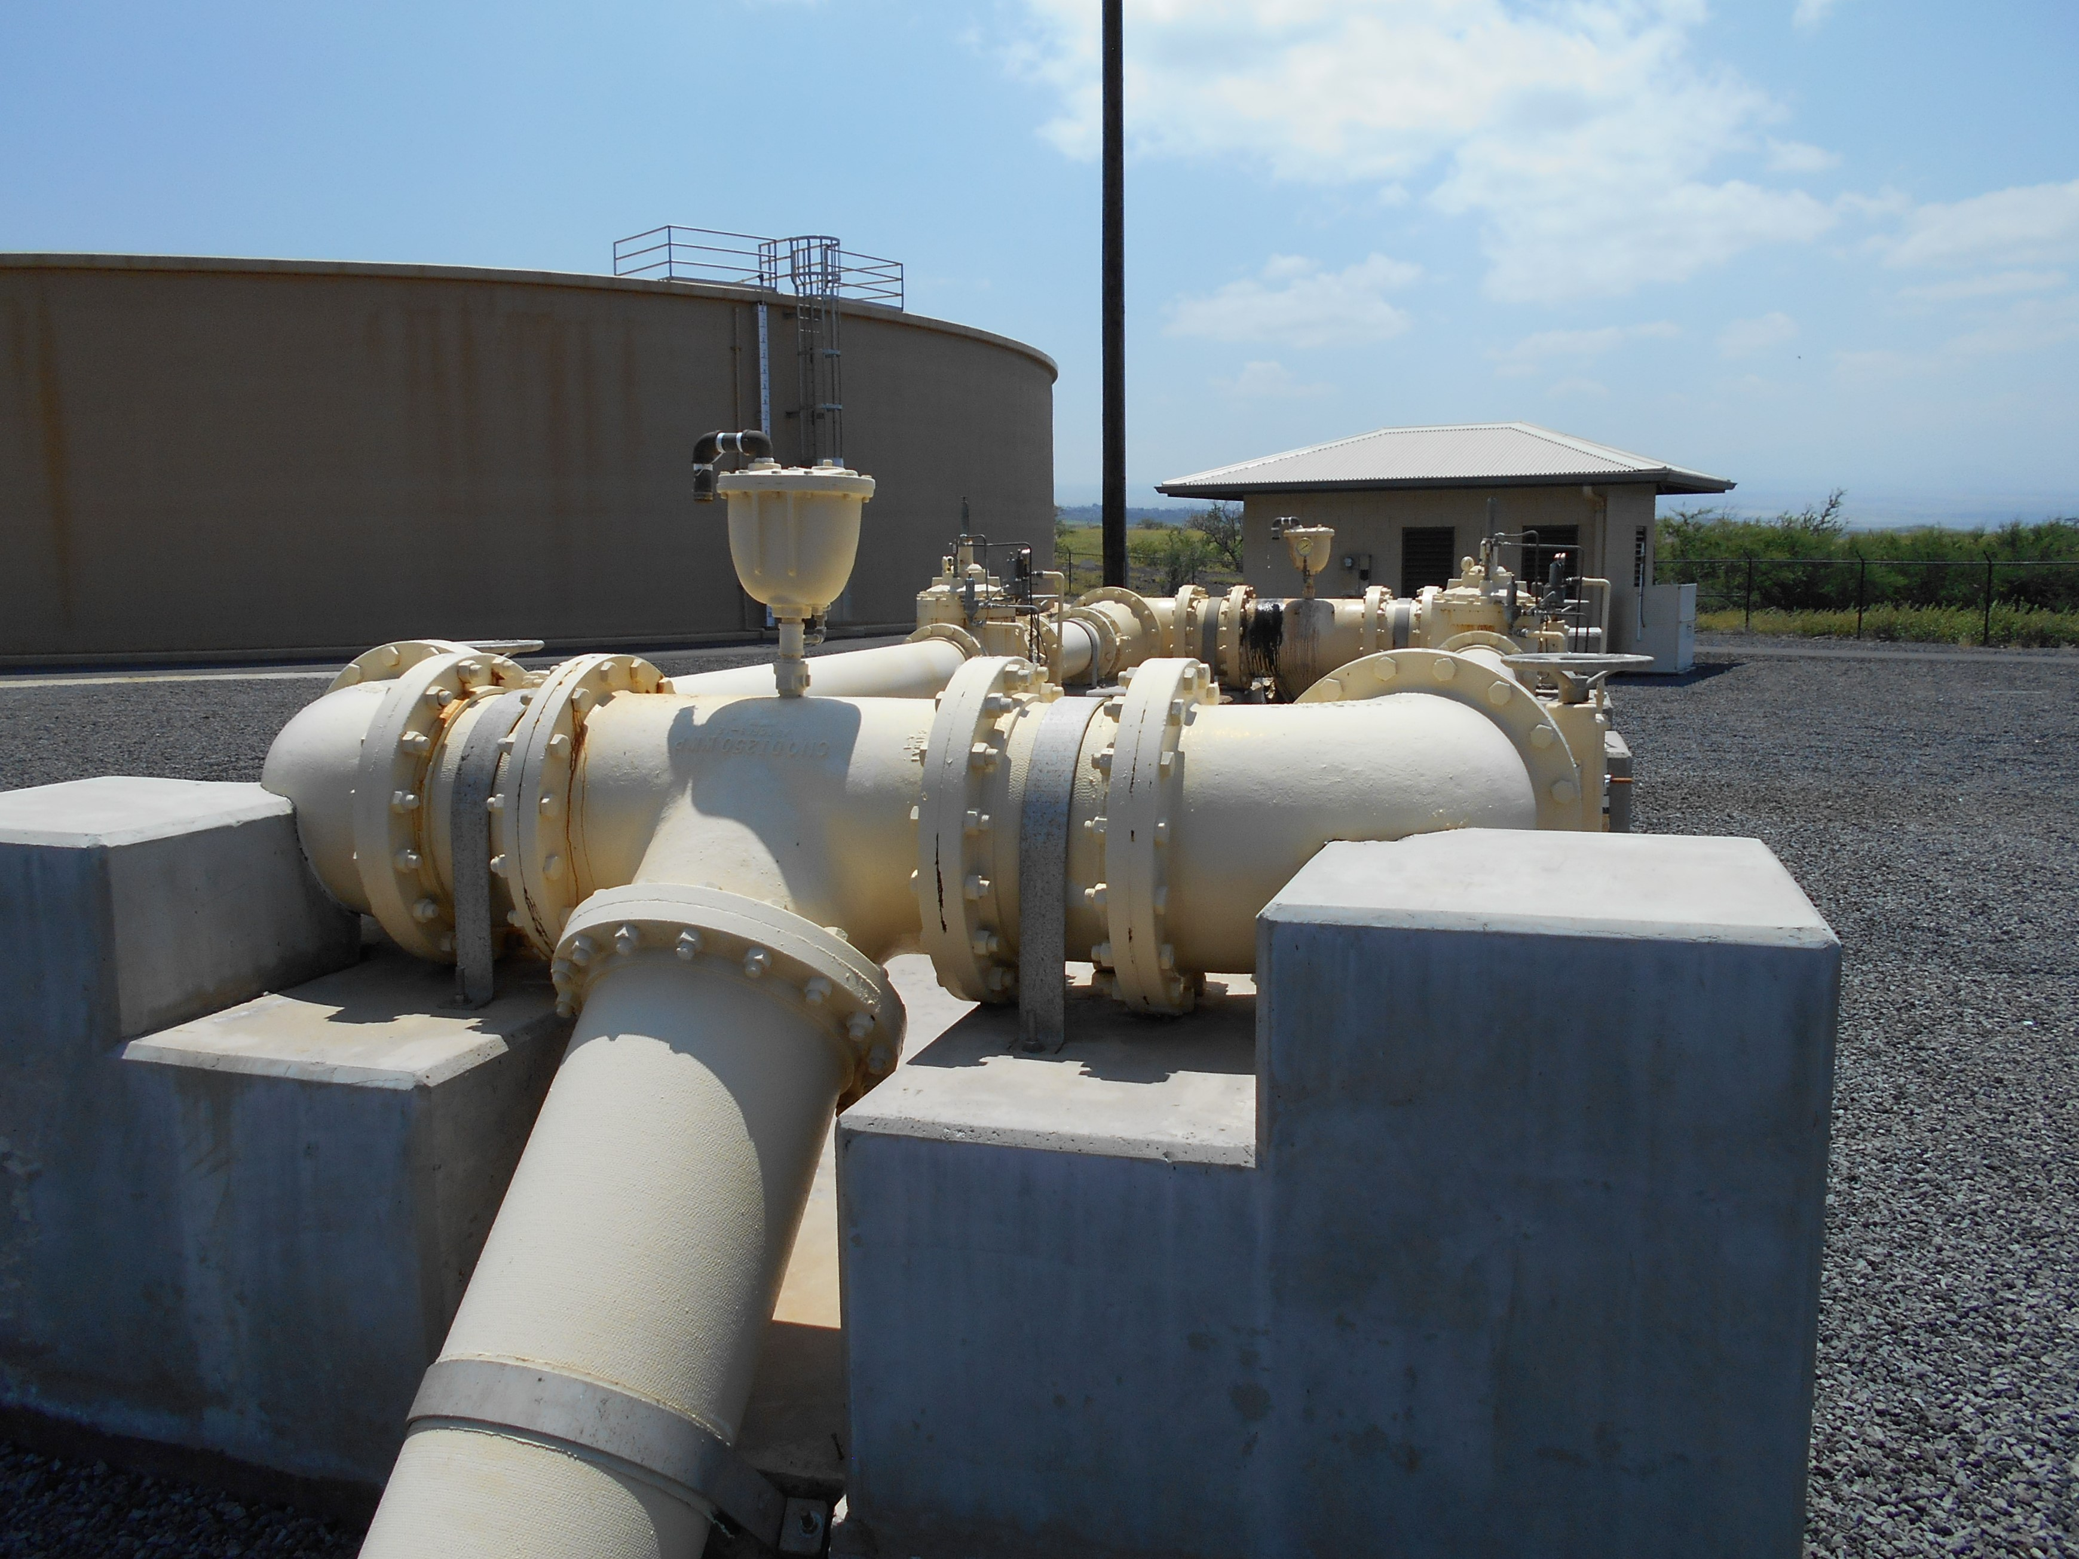
“Mixing Wind with Water”

Slide 3
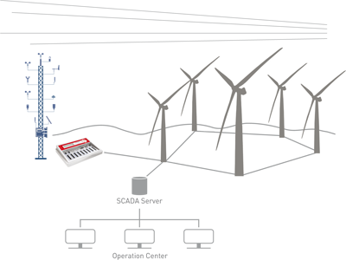
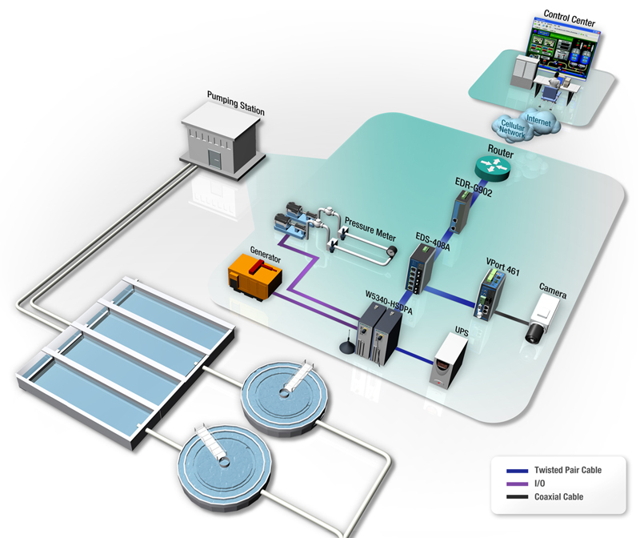
The Lalamilo Wind Farm integrates the Wind Energy produced on site to meet the power requirements needed to operate and monitor the various Department of Water Supply resources in the area.
These systems are uniquely specialized and are comprised of two independent SCADA (Supervisory Control And Data Acquisition) systems working in parallel while communicating and sharing data to achieve maximum efficiency.
WATER SCADA
Wind SCADA

Slide 4
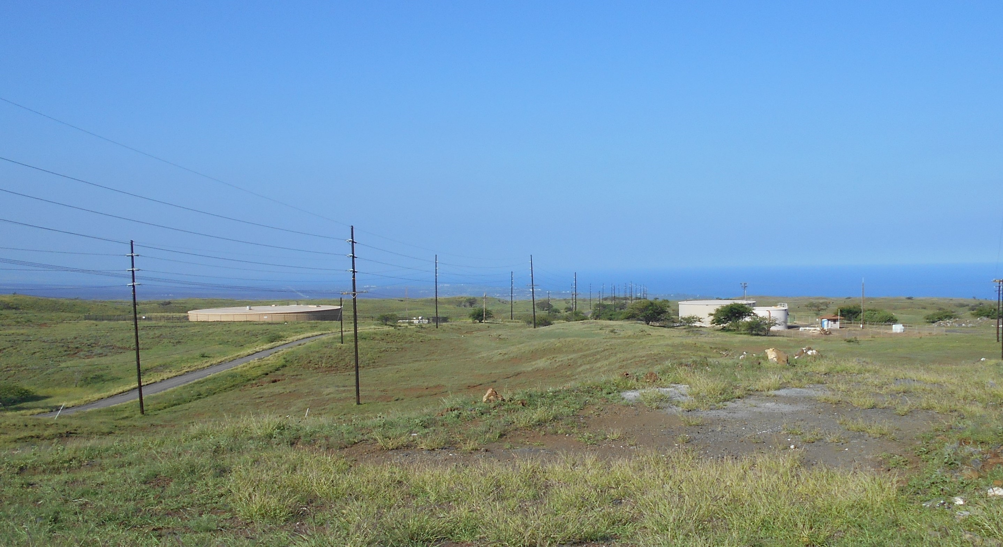
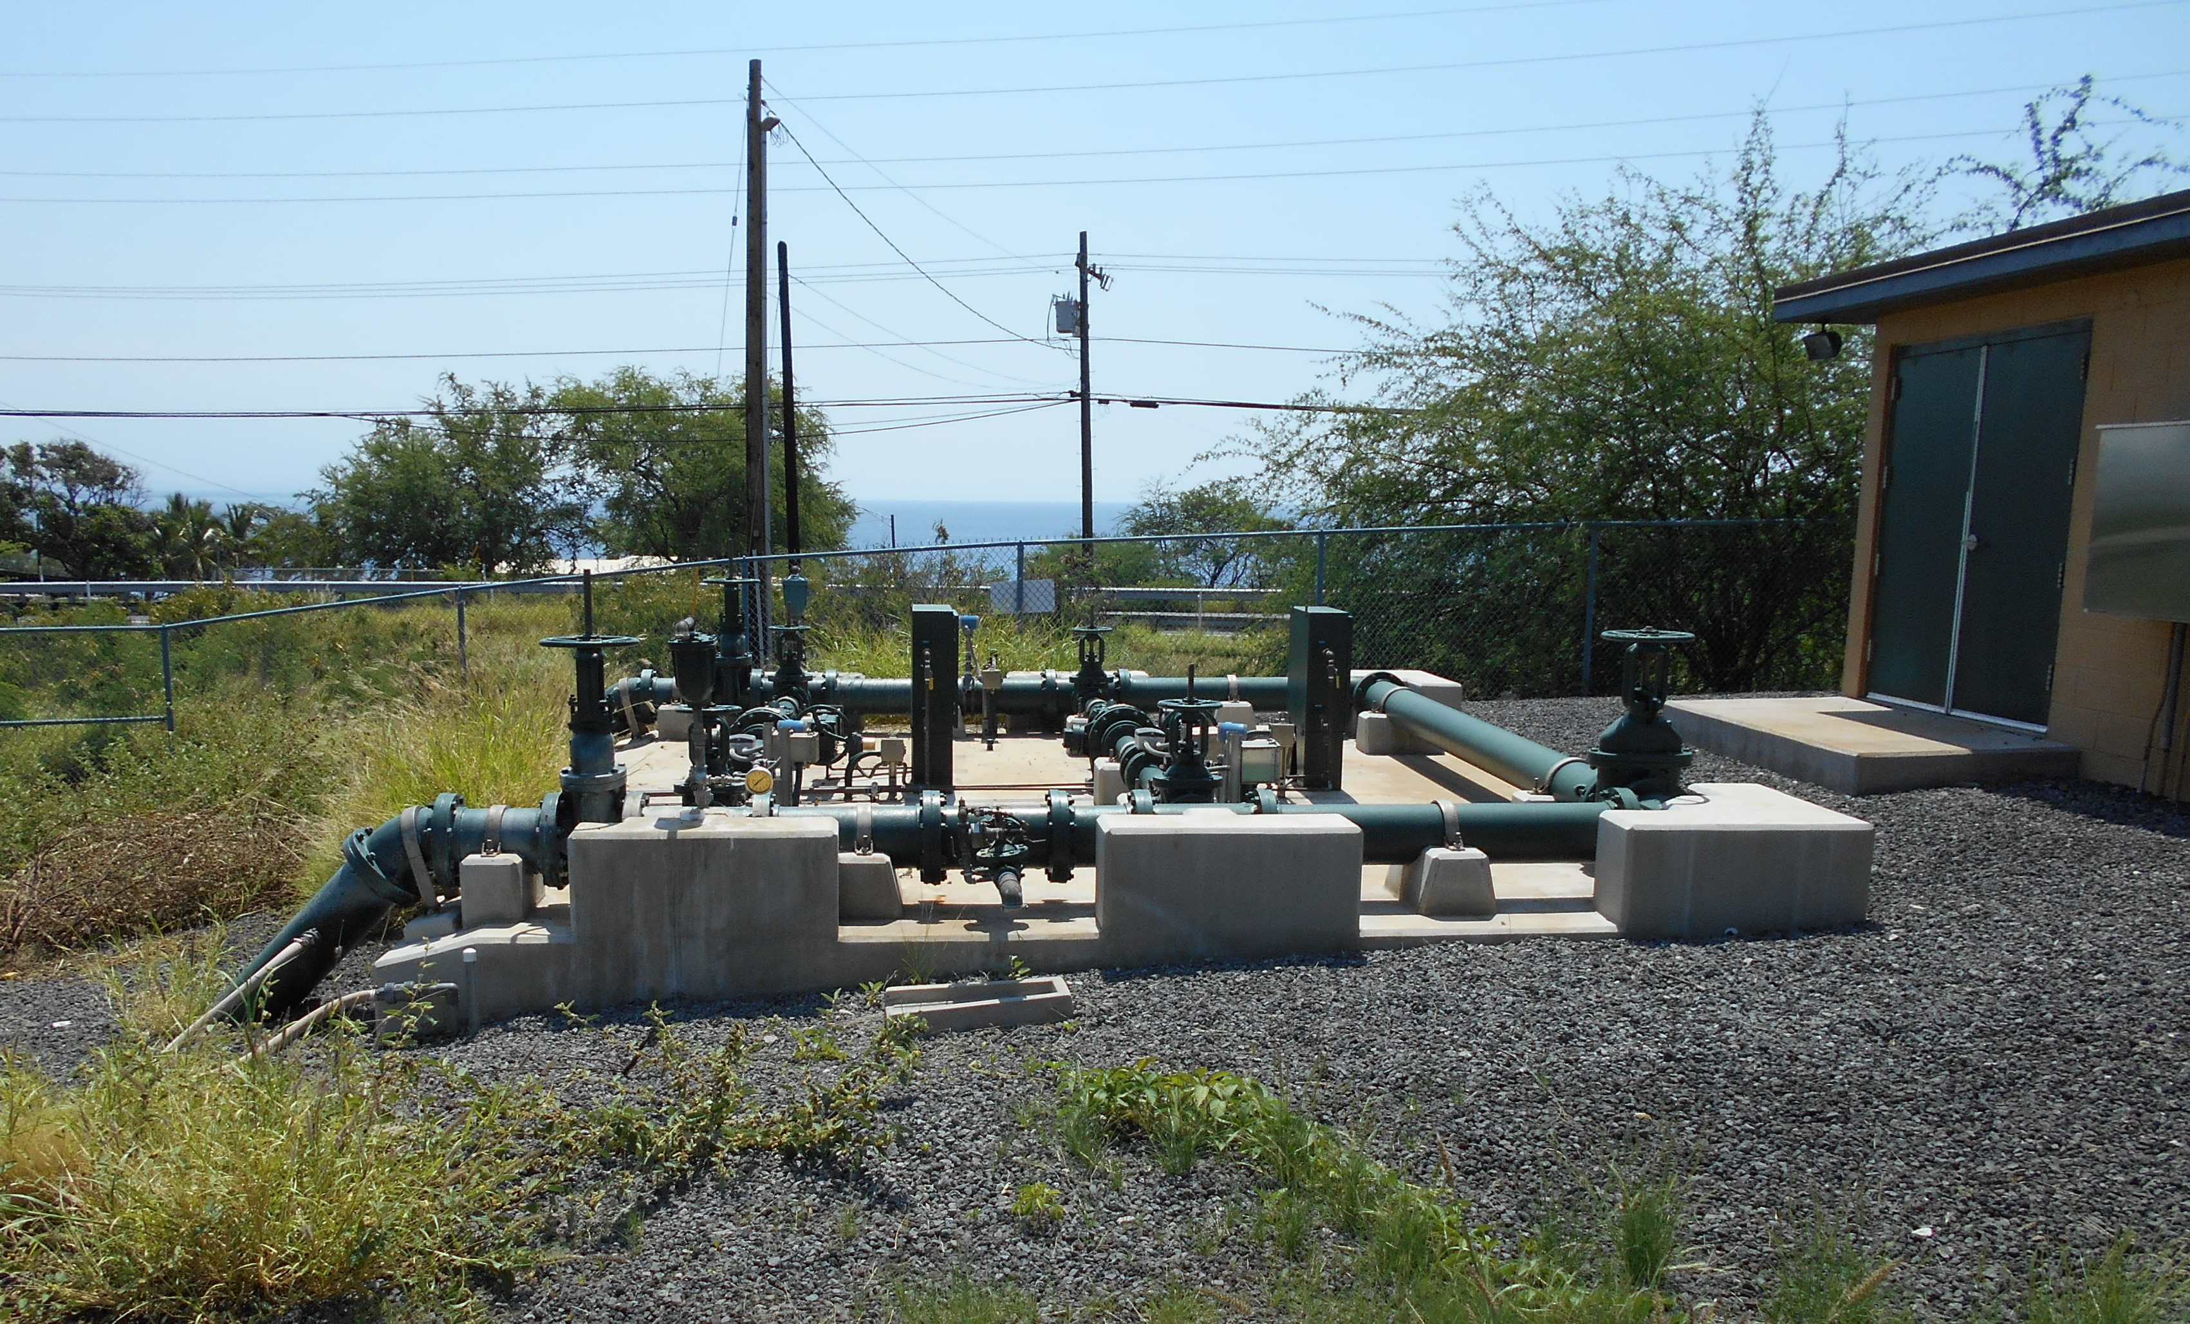
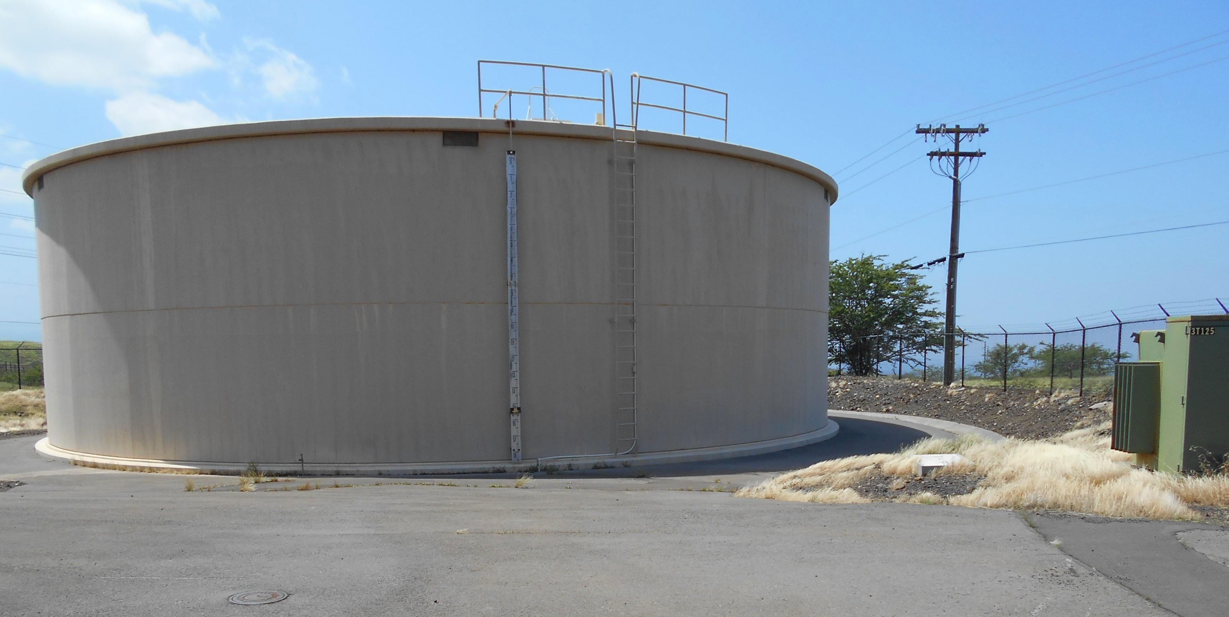
The water SCADA system monitors reservoir levels at over 10 sites including Kawaihae; nearly 6 miles away, while remotely controlling the 8 wells locally to provide water to the various reservoirs as required.

Slide 5
The Windcapture® SCADA system monitors the power demand of the water SCADA system, and operates the wind turbines to provide energy for the wells while keeping the power generation below the demand; avoiding the export of power to the HELCO grid. The Windcapture® SCADA system remotely operates the 5 – Vestas V 47 turbines. The power output of these turbines may be regulated up to 660 kW. and could potentially produce up to 3.3 Mega Watts. The system also monitors the power systems at the substation where the wind generated power is collected and distributed. It simultaneously monitors the HELCO supply circuit, 2 water well circuits, a power correction system and the windfarm output circuit 24-hours a day. It also stores the data in servers for various comparative and reporting purposes.

Slide 6
How it works at a glance To determine the desired windfarm output, the system measures the well system demand and calculates the desired power output. Using that number, the system determines how many turbines are required to produce the desired power. It then balances the power commands among the operating turbines to produce the demand required. (minus a small safety factor). If the required wind energy is not available, the system will still command the turbines to operate, taking advantage of the available wind. However, In low wind conditions, the system often still provides some additional energy.

Slide 7
The water system is separated from the wind system and operates the wells regardless of the power availability. However, the water system does provide the wind system with a warning when a well is ready to stop. When this occurs, the wind system automatically lowers the power demand value so the system will not export power to HELCO. To satisfy HELCO’s requirements, the system provides status information directly to HELCO, and accepts three commands from HELCO operators. The system can be set to operate normally, operate under curtailment (limiting the power generation) or can be commanded to operate at full capability. This system also has a feature to limit operation based on time-of-day. which is how we are currently operating.

Slide 8
Communications, Security and Operation A hybrid communications system was designed utilizing high speed radios, fiber optic networks and low frequency radios to allow secure communications across the various DWS assets and the wind farm itself. Using the same physical network equipment, the wind and water SCADA systems are separated by Virtual Private Networks, commonly called VPN’s. This ensures only authorized users have access to the equipment. These VPN connections were developed to meet or exceed Federal Energy Regulatory Commission (FERC) security requirements.

Slide 9
Monitoring of the wind farm system is provided through a web based application, again only accessible through an external VPN connection. This connection provides a secured access point to the SCADA systems’ and isolates users from the individual internal system components through IIoT. (Industrial Internet of Things) This also allows for systems maintenance without the need for technicians to be on-site. In fact, much of the fine tuning and programming of the systems has been accomplished from the SCADA Solutions office’s in Southern California. A systems integrator at the leading edge of this technology. The system also sends performance information emails and text based alerts to notify operators of unusual events or alarm conditions.

Slide 10
The system has been in test operation since Fall 2016. Currently the system is restricted to operating during daylight hours. However, the capability to operate throughout the entire 24-hour period should provide significantly more energy and reduce the energy demand from HELCO in the future.

